Slide 1
Hr Analytics Job Prediction EDA
File created on: 3/26/2024 7:46:59 AM

Slide 2
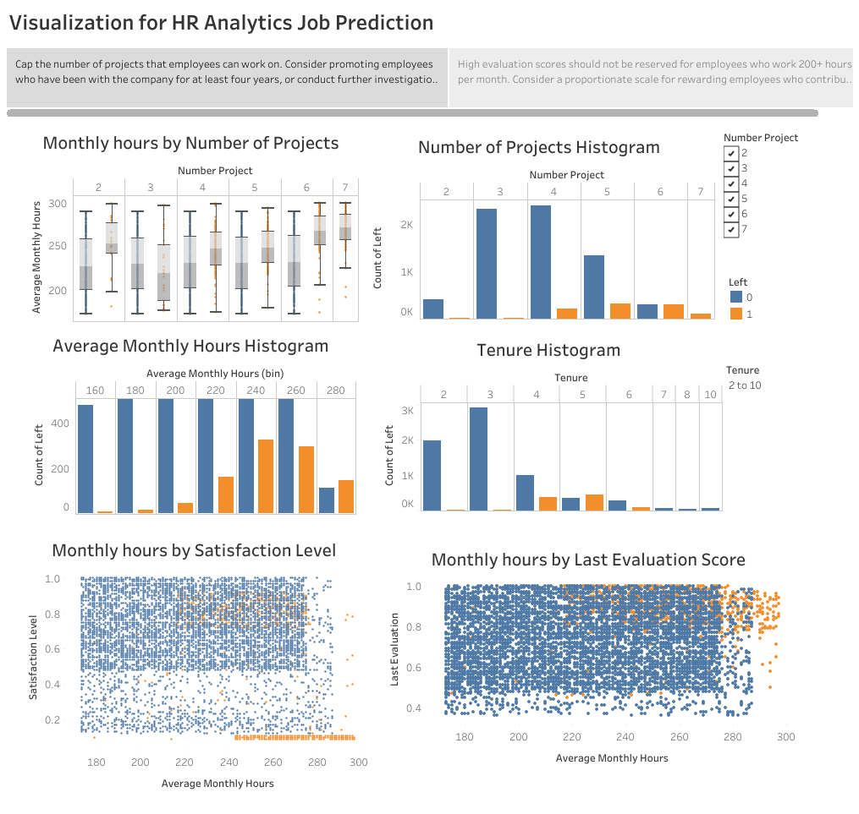

Slide 3
